Slide 1

Sigmoid Function
Showcase the sigmoid (logistic) function, which maps input values to probabilities between 0 and 1. Illustrate its characteristic S-shaped curve and how it transforms linear predictions into probabilities
DONE BY:
Adabala.Devi
Batch Name: MIP-ML-12

Slide 2

Introduction to the Sigmoid Function
Definition: The sigmoid function, also known as the logistic function. A sigmoid function is a mathematical function with a characteristic "S"-shaped curve or sigmoid curve. It transforms any value in the domain (−∞,∞) to a number between 0 and 1.
Purpose: Commonly used in binary classification to transform linear predictions into probabilities.

Slide 3


Mathematical Definition
Formula:
Explanation:
𝜎(𝑥) is the output of the sigmoid function.
𝑥 is the input value.
𝑒 is the base of the natural logarithm (approximately 2.718).

Slide 4
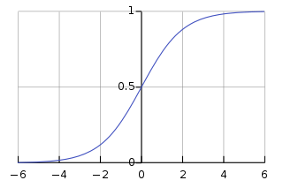

Characteristic S-shaped Curve
Graph:
Graph of the Sigmoid Function:
X-axis: Input value (x)
Y-axis: Output value (σ(x))
Description:
The graph below shows the sigmoid function, highlighting its S-shaped curve.
The function approaches 0 as 𝑥 approaches -∞.
The function approaches 1 as 𝑥 approaches +∞.
The function is centered at x=0, where 𝜎(0)=0.5.

Slide 5
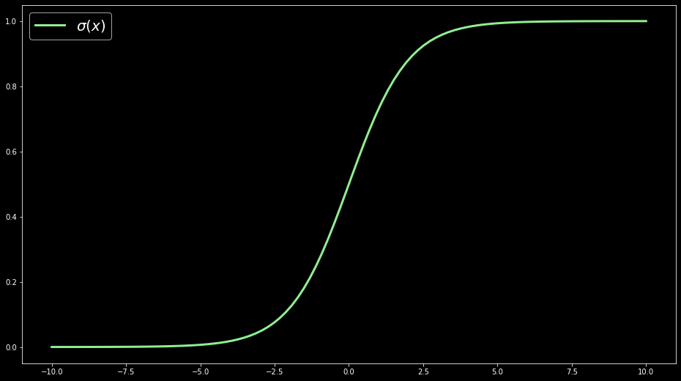
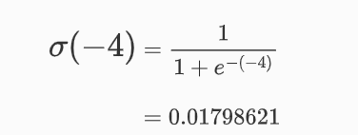

Limits of the sigmoid function
Show a plot of the sigmoid function with 𝑥 ranging from -10 to 10.
If the input 𝑥 to the sigmoid function is a small negative number, the output is very close to 0. For example:

Slide 6
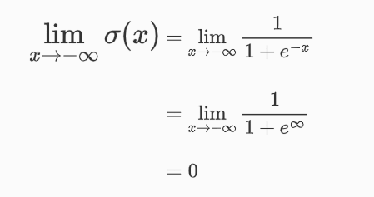
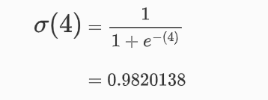
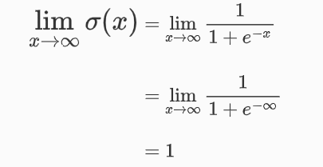
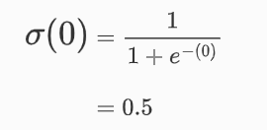

2. Indeed, we can use the limit to show that 𝜎(𝑥) approaches 0 as 𝑥 tends to −∞:
3. If 𝑥 is a large positive number, then the output is very close to 1:
4. Again, we can use the limit to show that 𝜎(𝑥) approaches 1 as 𝑥 tends to ∞:
5. If 𝑥 is exactly 0, the output is 0.5:

Slide 7

Properties of the Sigmoid Function
Range: (0, 1)
Output Interpretation:
Values close to 0 indicate low probability.
Values close to 1 indicate high probability.
Symmetry: The function is symmetric around x=0.

Slide 8


Transforming Linear Predictions
Linear Model:
𝑤 is the weight.
x is the input feature.
b is the bias.
Applying Sigmoid:
Interpretation: The linear prediction 𝑧 is transformed into a probability 𝑦^.

Slide 9
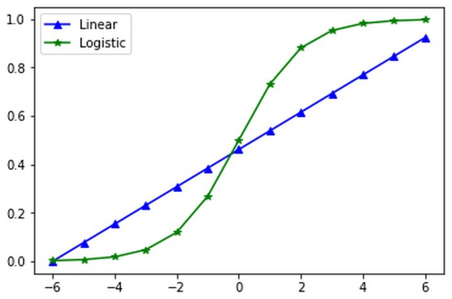

Visualizing the Transformation
Graph:
Plot both the linear function 𝑧=𝑤⋅𝑥+𝑏 and the transformed sigmoid output 𝜎(𝑧) on the same graph.
Show how the linear outputs map to the S-shaped sigmoid curve.
Illustration:
Highlight how extreme values of z are squashed into probabilities between 0 and 1.

Slide 10

Transformation Explanation:
Linear to Probabilistic:
The sigmoid function takes a linear input z and transforms it into a probability 𝜎(𝑧), which lies between 0 and 1.
This transformation is particularly useful in binary classification tasks, where the goal is to predict the likelihood of an event occurring.

Slide 11

Example: Binary Classification
Scenario:
Predict whether a customer will buy a product (0 = No, 1 = Yes).
Linear Model Output: z ranges from -5 to 5.
Sigmoid Output: 𝑦^=𝜎(𝑧).
Mapping Linear Outputs to Probabilities:
For 𝑧=0, σ(z)=0.5
For 𝑧=2, σ(z)≈0.88
For z=−2, σ(z)≈0.12
The sigmoid function squashes large positive and negative values of 𝑧 into probabilities close to 1 and 0, respectively.

Slide 12
Advantages of the Sigmoid Function
Smooth Gradient:
Suitable for gradient-based optimization.
Output Range:
Constrains outputs to a meaningful range (0 to 1).
Probabilistic Interpretation:
Directly interpretable as probabilities.
Limitations of the Sigmoid Function
Vanishing Gradients:
Gradients can become very small for large positive or negative inputs, slowingdown training.
Output Not Zero-Centered:
All outputs are positive, which can lead to inefficient updates.

Slide 13
Applications of the Sigmoid Function
Logistic Regression: Binary classification problems.
Neural Networks:
Activation function in output layer for binary classification.
Probabilistic Models:
Models that require probability outputs.

Slide 14
Conclusion
The sigmoid (logistic) function is a mathematical function used in various fields, particularly in machine learning and statistics, to map any real-valued number into a value between 0 and 1, making it ideal for probability estimation. The function is defined as σ(x)=1/1+e^-x​, where e is the base of the natural logarithm.
function transforms input values, often linear predictions from models, into a probability distribution, facilitating binary classification tasks. The characteristic S-shaped curve of the sigmoid function reflects its gradual transition from 0 to 1, with a central inflection point at 𝑥=0 where 𝜎(0)=0.5. As 𝑥 approaches negative infinity, 𝜎(𝑥) asymptotically approaches 0, and as x approaches positive infinity, σ(x) asymptotically approaches 1.
This smooth, continuous transformation makes the sigmoid function particularly useful for neural networks and logistic regression, enabling them to output probabilities that can be interpreted and manipulated in subsequent analytical or decision-making processes.
In conclusion, the sigmoid function's ability to convert linear predictions into probabilistic interpretations underpins its utility in various predictive modeling scenarios, providing a reliable mechanism to gauge outcomes in a probabilistic framework.

Slide 15
THANK YOU

